Slide 1




From Cloud to Edge: A First Look at Public Edge Platforms
ACM Internet Measurement Conference 2021
Mengwei Xu, Zhe Fu, Xiao Ma, Li Zhang, Yanan Li, Feng Qian,
Shangguang Wang, Ke Li, Jingyu Yang, Xuanzhe Liu
Notes:
Hi everyone, I am Li Zhang from Beijing University of Posts and Telecommunications. I am glad to present our work: the first measurement on a commercial, public edge platform. This is joint work with Tsinghua University, University of Minnesota, and Peking University.

Slide 2







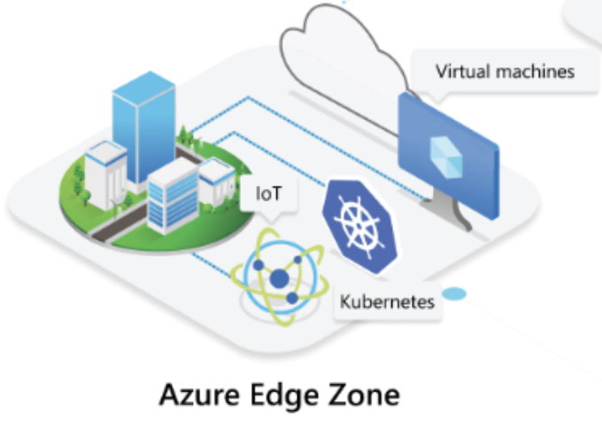


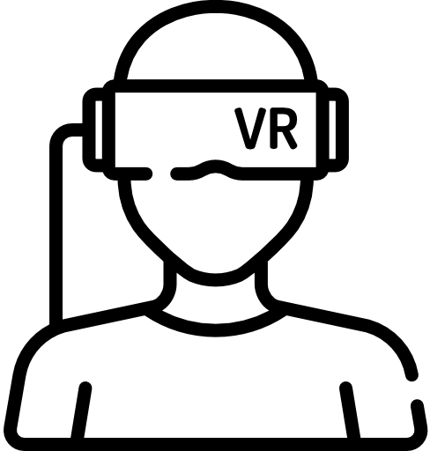

Current Edge Platforms
Cloud Providers
Edge Platforms
Edge Applications
Autonomous driving
AR/VR
Smart city
Notes:
Current cloud providers provide wide-range edge computing services by building and deploying their edge platforms, such as Azure Edge Zones and AWS Local Zones.
These infrastructures brings computation and storage closer to end-users, aims to benefit a lot of interactive applications, for example, autonomous driving, AR/VR, and smart cities.

Slide 3
Overview of NEP
What is NEP?
Alibaba ENS^{[1]}
A leading edge platform in China, providing IaaS, PaaS, FaaS, etc.
What consists of NEP physical servers?
Built atop Alibaba CDN.
Cooperative third-party IDCs and network operators.
Mainly based on micro datacenters rather than sinking into cellular core networks.
[1] Extending the Boundaries of the Cloud with Edge Computing
https://www.alibabacloud.com/blog/extending-the-boundaries-of-the-cloud-with-edge-computing_594214
Notes:
In this paper, we will analyze NEP, which is commercially known as Alibaba ENS, a leading edge platform in China.
The primary differences between NEP and current platforms are how physical servers are located and organized. Cloud providers usually build their large datacenters across geographical locations, while edge providers treat geo-distribution as their first-class target.
More specifically, NEP is built atop Alibaba CDN, and cooperates with third-party IDCs and network operators, but is mainly based on micro datacenters rather than sinking into cellular core networks.

Slide 4
Overview of NEP
The deployment scale of NEP is larger than current edge/cloud platforms!
Notes:
This table shows the deployment scale and density of NEP. Compared with Azure and AWS, NEP is now located in China and covers more than 500 regions.
[press]
The deployment scale of NEP is larger than current edge and cloud platforms.

Slide 5


Benefits of NEP-like Edge Platforms
Latency reduction, application performance improvement.
Resource saving (e.g., bandwidth).
But all parties are still wondering:
End users: How much latency and QoE are improved?
Cloud providers: How much bandwidth and other resources are saved?
We need quantitative characteristics of NEP-like edge platforms.
Notes:
The benefits of edge computing provided by current edge platforms are well known, such as latency reduction, application performance improvement and resource (bandwidth) saving, but there lacks quantitative characteristics of these improvements. So in this work, we conduct to our knowledge, the first measurement on a commercial public edge platform, to reveal the quantitative benefits of NEP-like edge platforms.

Slide 6


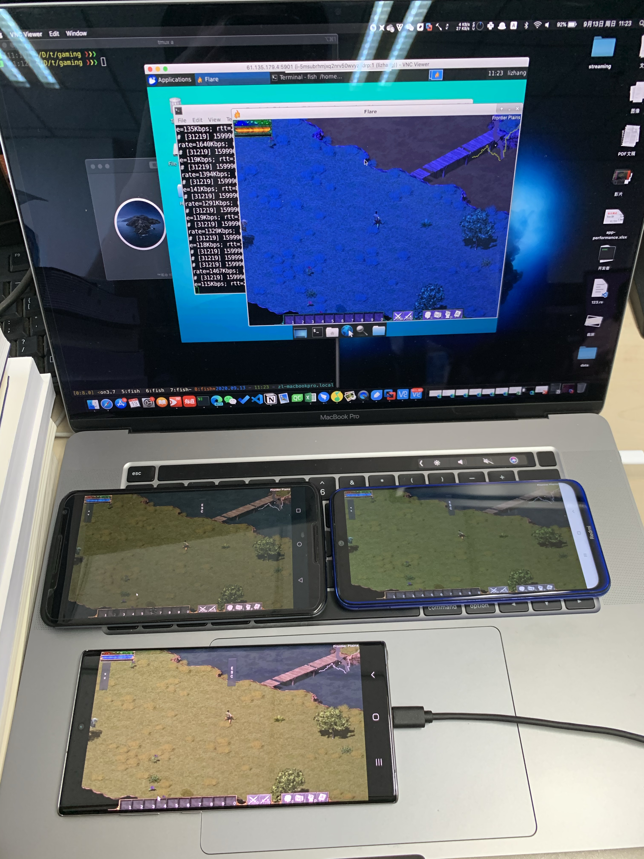

Measurements over NEP
Nodes: small DCs at different locations
IaaS VMs
Edge Apps
Beijing-1
Beijing-2
Servers
Shanghai
Shenzhen
complete VM traces
Wi-Fi / LTE / 5G / Wired
videos
traceroute
iPerf3
Player actions
& Game display
Live Streaming
UEs
Cloud Gaming
Edge performance
Edge workloads
characterization
Notes:
To begin with, I will introduce the overview of the measurements:
The measurements over NEP are two-fold: Edge performance measurement from end users’ perspective and Edge workloads characterization from edge providers’ perspective.

Slide 7
Measurements over NEP
Nodes: small DCs at different locations
IaaS VMs
Edge Apps
Beijing-1
Beijing-2
Servers
Shanghai
Shenzhen
complete VM traces
Wi-Fi / LTE / 5G / Wired
videos
traceroute
iPerf3
Crowd-sourcing experiments from 158 participants in 41 cities across China.
Edge performance metrics:
Network latency
Network throughput
player actions
& Game display
Live Streaming
UEs
Cloud Gaming
Notes:
For edge performance, we first conduct crowd-sourcing experiments to dig the latency and throughput improvement.

Slide 8
Measurements over NEP
Nodes: small DCs at different locations
IaaS VMs
Edge Apps
Beijing-1
Beijing-2
Servers
Shanghai
Shenzhen
complete VM traces
Wi-Fi / LTE / 5G / Wired
videos
traceroute
iPerf3
Controlled experiments by authors.
Application-level QoE:
Cloud gaming
Live streaming
Player actions
& Game display
Live Streaming
UEs
Cloud Gaming
Notes:
Then we perform controlled experiments, using cloud gaming and live streaming to test the application-level Quality of Experience.

Slide 9
Measurements over NEP
Nodes: small DCs at different locations
IaaS VMs
Edge Apps
Beijing-1
Beijing-2
Servers
Shanghai
Shenzhen
complete VM traces
Wi-Fi / LTE / 5G / Wired
videos
traceroute
iPerf3
Offline analysis of Edge workloads.
Edge workloads metrics:
VM subscription
Resource usage
Application on NEP, Monetary cost, etc.
player actions
& Game display
Live Streaming
UEs
Cloud Gaming
Notes:
We analyze NEP’s workloads offline, including VM subscription and resource usage, etc.

Slide 10
Experiment Settings
Edge and cloud servers
Network latency: one VM on each edge site^{[1]} of NEP and each cloud region of AliCloud.
Network throughput: 20 NEP VMs at different sites.
Crowd-sourcing participants
Network latency: 158 users from 20 provinces, 41 cities in China, 59%/34%/7% of the results under Wi-Fi/LTE/5G.
Network throughput: 25 volunteers which is a subset from above 158 users.
Software
Use traceroute (ICMP) and iPerf3 (TCP) to obtain the network latency and throughput.
[1] A site refers to a datacenter at some location, which consists of many servers, and each server hosts many VMs.
Notes:
For network latency testing, we set up one VM on each edge site of NEP and each cloud region of AliCloud, and make all participants install our testing application on their Android devices. The testing application will obtain a round-trip time and intermediate hops to each server.
We also set up twenty NEP VMs at different sites with 25 volunteers using iPerf3 to get the network throughput.

Slide 11
Edge Performance: Latency
Median RTT across users
1.9X/3.4X faster than the nearest cloud/all clouds!
Notes:
As the left figure shows, we aggregate median RTT across users to the nearest edge, the third-nearest edge, the nearest cloud, and all clouds.
We can see that, edge VMs deliver lower latency compared to cloud VMs.
Under 5G, the lowest median RTT to the nearest edge is 10.4ms.
And RTT to the nearest edge is 1.9 times and 3.4 times faster than the nearest cloud and all clouds under Wi-Fi.

Slide 12
Edge Performance: Latency
Median RTT across users
RTT coefficient of variation (CV) across users
1.9X/3.4X faster than the nearest cloud/all clouds!
The nearest cloud has 5.8X/3.9X/5.7X higher median RTT CV under
Wi-Fi/LTE/5G!
Notes:
We also measure the RTT coefficient of variation. Taking RTT CV to the nearest edge as the baseline, the nearest cloud has 5.8 times / 3.9 times / 5.7 times higher median RTT CV under Wi-Fi/LTE/5G.
We think such a low network jitter is critical to provide service-level agreement to edge customers.

Slide 13
Edge Performance: Latency
Median RTT across users
RTT coefficient of variation (CV) across users
Edge VMs deliver lower and more stable network latency compared to Cloud VMs.
The best RTT remains 10.4ms to the nearest edge VM under 5G.
Notes:
We can say that Edge VMs deliver lower and more stable network latency compared to Cloud VMs.

Slide 14
Edge Performance: Hop number
5-12 hops
10-16 hops
Notes:
To further understand the network latency, we analyze the hop number and hop-level latency breakdown.
The hop number to the nearest edge ranges from 5 to 12 hops, which is much fewer than the clouds (which range from 10 to 16 hops).

Slide 15
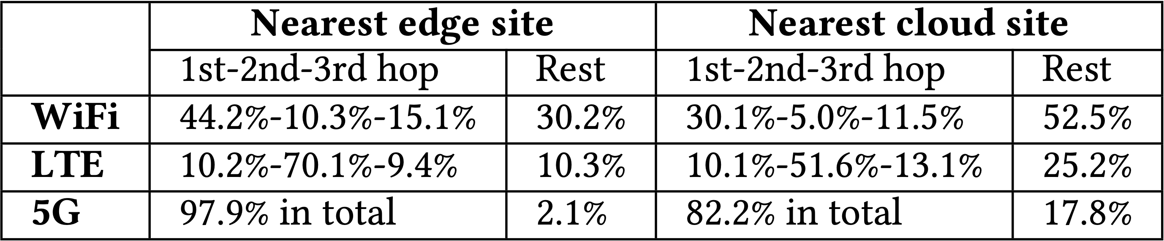
Edge Performance: Hop number
5-12 hops
10-16 hops
The reduced hop number leads to lower network latency and jitter.
The first 3 hops dominate more than 70 percent of the total latency for the nearest edge site.
Implication: To reached the envisioned prospects of edge computing, NEP needs to deploy denser sites and collaborate with operators to sink the edge resources into ISP‘s core networks or even cellular base stations.
Notes:
We breakdown the hop-level latency and highlight the latency of the first three hops and combine the rest. Compared with the nearest cloud site, the first 3 hops dominate more than 70 percent of the total latency, when connecting to the nearest edge site, even 98 percent in 5G, which means that, the current deployment of NEP mainly reduces the inter-city transmission delay.
[press]
From the results, we implicate that, to further reduce the hop number and latency, NEP needs to increase the site density and sink the resources into the core network by collaborating with operators.

Slide 16
Edge Performance: Throughput
Downlink throughput
Uplink throughput
TCP-based throughput testing.
Running iPerf3 for 15 seconds each test.
Corr is calculated by Pearson correlation coefficient.
Notes:
For throughput testing, we want to find how does the geographic distance affects the network throughput, so help us understand how NEP-like edge platforms improve the network throughput compared to remote clouds.
Our key observation is that, [press], when throughput is low, for example, less than 100 Mbps for LTE and Wi-Fi, the correlation between the distance and throughput is negligible.

Slide 17
Edge Performance: Throughput
Downlink throughput
Uplink throughput
TCP-based throughput testing.
Running iPerf3 for 15 seconds each test.
Corr is calculated by Pearson correlation coefficient.
Implication: Bringing resources closer to users improves network throughput on NEP only with high bandwidth capacity at the last mile. Throughput improvement will benefit more emerging, bandwidth-hungry edge applications in the future.
Notes:
Only when the throughput reaches high, [press] as 5G downlink and wired access, the correlation becomes significant, and the throughput degrades as physical distance increases.
[press]
The reason is that, with LTE/Wi-Fi access, the network throughput is usually bounded by the bandwidth capacity at the wireless hop, but when capacity is high, the bottleneck resides at the Internet link.
In the future, we think more emerging and bandwidth-hungry edge applications will benefit from the throughput improvement.

Slide 18
Experiment Settings: Application QoE
Deploy one nearest edge and three cloud servers (670KM/1300M/2000KM away from experiment performed!)
Software deployment:
GamingAnywhere^{[1]} for cloud gaming.
End-to-end streaming app using RTMP protocol.
Player
actions
videos
videos
Game
display
Live Streaming
Cloud gaming
[1] GamingAnywhere – An Open Source Cloud Gaming System https://gaminganywhere.org/
Notes:
Through our controlled experiments, we deploy cloud gaming and live streaming backend on NEP sites.
For cloud gaming, we follow prior work to measure the end-to-end performance, and I will present the results.

Slide 19
Edge Performance: Cloud Gaming
Implication: Placing gaming backend on nearby NEP edges help achieve less than 100ms response delay. To further enhance the experience, we need to improve the server-side gaming execution.
Notes:
The response delay of cloud gaming is shown in the figure. Overall, with a good network condition (like Wi-Fi in our case) and nearby VMs, [press], cloud gaming can achieve less than 100ms response delay, and the distance matters. The remote cloud VMs lengthen the delay by up to 60ms.
Corresponding RTT results show that, to reduce the response delay, the network latency to the nearest edge VM is no longer the bottleneck (the propagation delay is only about 12 ms).
[press]
By our results, we think, to achieve better gaming performance, developers need to improve the server-side gaming execution.

Slide 20
Edge Workloads: Total Analytics
Compare with Azure cloud dataset^{[1]}
VM subscription
CPU usage
Application of NEP (e.g., Application type, VM numbers per application)
Bandwidth usage
Resource load balance
Monetary of NEP
[1] Resource Central: Understanding and Predicting Workloads for Improved Resource Management in Large Cloud Platforms. (SOSP '17).
Notes:
Next, I will introduce the analytics of edge workloads.
We choose Azure Dataset in 2019 for comparison.
Due to the time limit, I will show the VM subscription and CPU usage of edge workloads. More details can be seen in our paper!

Slide 21
Edge Workloads: VM subscription
Number of vCPUs per VM
Memory size per VM
Small / median / large represents ≤4 / 5-16 / >16 CPU cores or GBs memory.
Implication: The large VM size on NEP-like edge platforms may cause severe resource fragmentation. Dynamic VM migration and resource disaggregation may help to solve this problem.
Notes:
First, we compare the number of resources allocated to each VM on NEP and Azure Cloud. It’s to be noted that, NEP provides very similar VM configuration options in terms of CPU and memory to customers as Azure Cloud does.
To briefly illustrate the observation, NEP VMs typically request more resources than Azure Cloud, such as
The median number of CPU cores is 8 for NEP compared with 1 for Azure.
The memory is 32GigaBytes for NEP while 4GigaBytes for Azure Cloud.
[press] With above observations, we implicate that the large VM size of NEP-like edge platforms may cause severe resource fragments. Dynamic VM migration and resource disaggregation may help to solve this problem.

Slide 22
Edge Workloads: Resource usage
CV=std/mean
Implication: The relatively low but highly skewed CPU usage challenges the NEP’s VM management. To better utilize the CPU resources, NEP may need smart VM placement algorithms or employ more elastic computing forms, e.g., containers together with IaaS VMs on the same server.
Notes:
We also analyze per-VM CPU usage on edge and cloud sites.
And we find that VM CPUs on NEP are much less utilized than Azure Cloud, either on average or the nighty-fifth percentile.
For example, 74 percent of NEP VMs have less than 10% CPU utilization on average, while this number is 47 for Azure Cloud.
We can say edge customers tend to over-provision the hardware resources for VMs.
We also find edge VMs exhibit more usage variance across time than the clouds. We think the reason is that applications deployed on edge platforms are more likely to be interactive so the usage highly depends on human activities.
[press]
We infer from the results that the relatively low but highly skewed CPU usage challenges the NEP’s VM management. To better utilize the CPU resources, NEP may need smart VM placement algorithms or employ more elastic computing forms.

Slide 23
Conclusions
The first comprehensive measurement on a commercial, multi-tenant edge platform.
Lead to insightful implications for designing future edge platforms and edge-based applications.
Edge workloads traces are open-sourced at: https://github.com/xumengwei/EdgeWorkloadsTraces
Notes:
OK! To conclude, we do the first comprehensive measurement on a commercial, multi-tenant edge platform. And our results lead to insightful implications for designing future edge platforms and developing edge-based applications.
In addition, we open-source edge workloads and hope this can help the edge computing community!

Slide 24

Thanks for your listening!
Edge workloads:
https://github.com/xumengwei/EdgeWorkloadsTraces
Special thanks to Alibaba Group for their contribution to this work!
Notes:
We give special thanks to Alibaba Group for their contribution to this work. And Thanks for your listening!

